Slide 1



Homogenization of the mass transport across thin porous membranes: from small to large Péclet numbers
École Polytechnique Fédérale de Lausanne
Università degli Studi di Genova
Supervisors:
Prof. Alessandro Bottaro, Università di Genova
Dr. Giuseppe Antonio Zampogna, EPFL
Prof. François Gallaire, EPFL
Candidate:
Alberto Ponte
29/03/2023

Slide 2
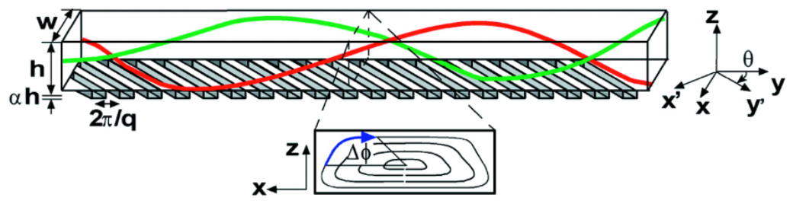








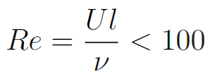
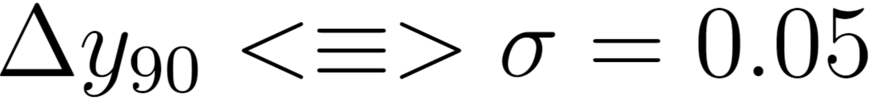
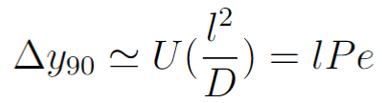
Large Péclet transport in microfluidics
Strook et al., Science 295 (5555), 2002.
The standard deviation of the solute defines the degree of mixing:
The mixing length is the distance from the inlet of the channel where the solution is mixed at the 90%:
Smooth surfaces
Slow diffusive mixing
…and if we consider permeable microstructured surfaces?
Microstructured impermeable pattern
Transverse flow component
Mixing length reduction

Slide 3
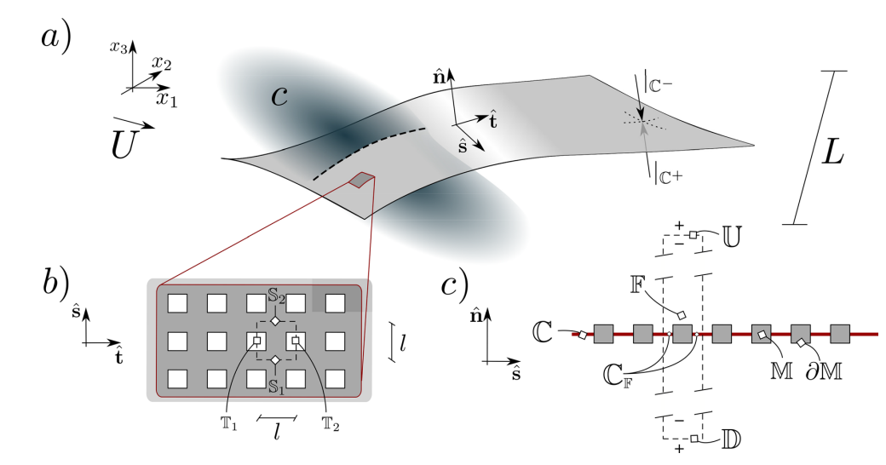
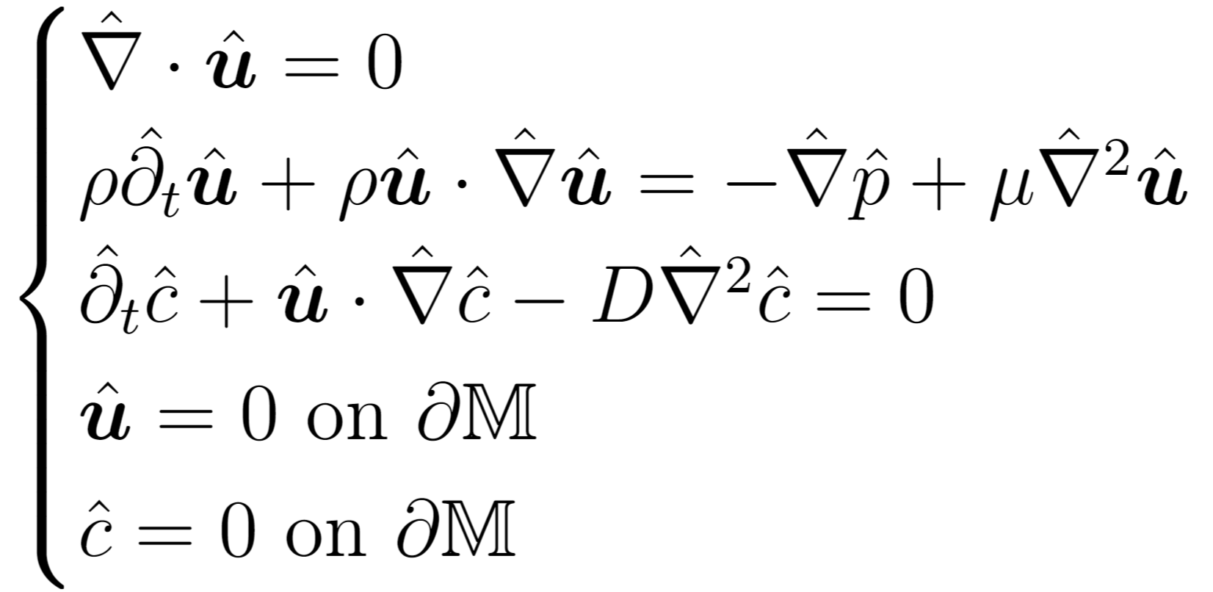
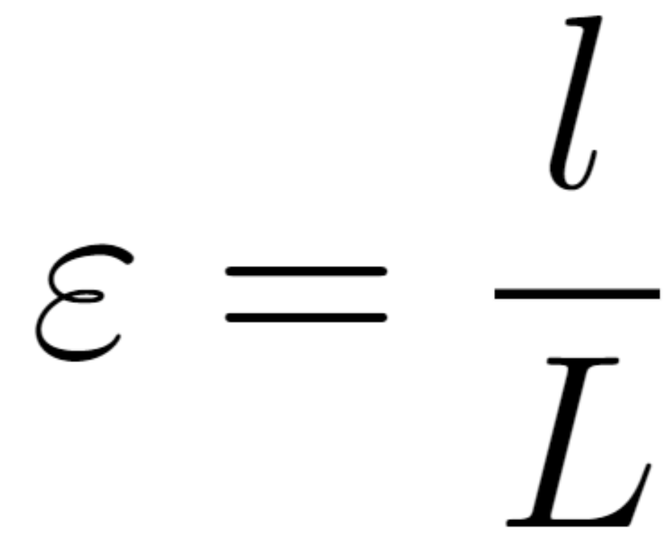
Governing equations
We consider an incompressible flow (u,p) of a Newtonian fluid (ρ,μ) carrying a diluted solute (c):
Zampogna et al., Phys. Fluids 34, 083113, 2022.
The microscopic cell is periodic within the membrane.

Slide 4
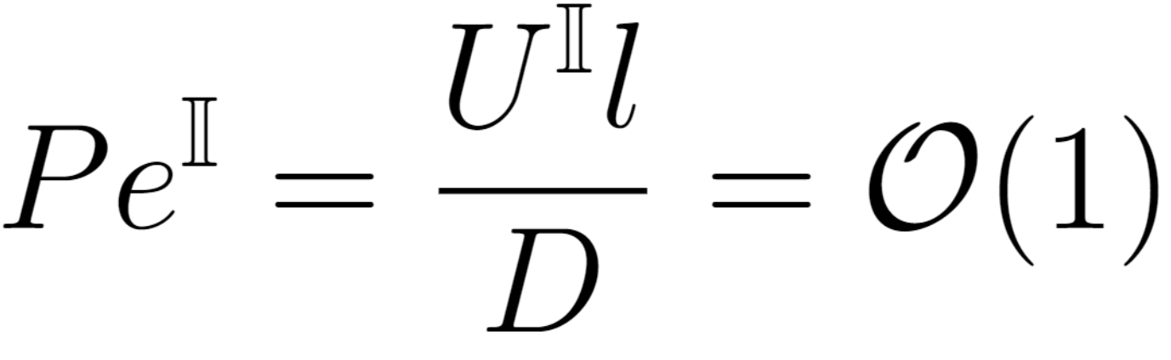
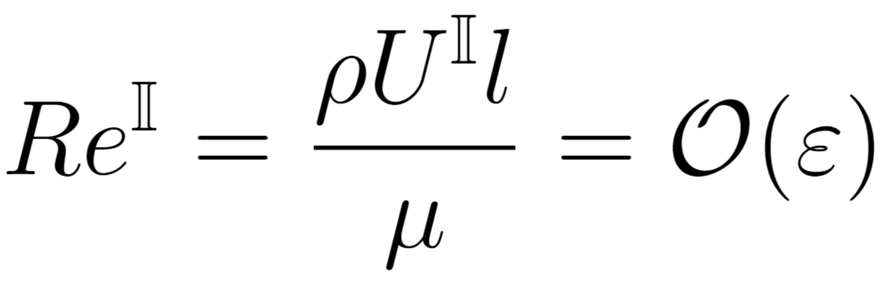
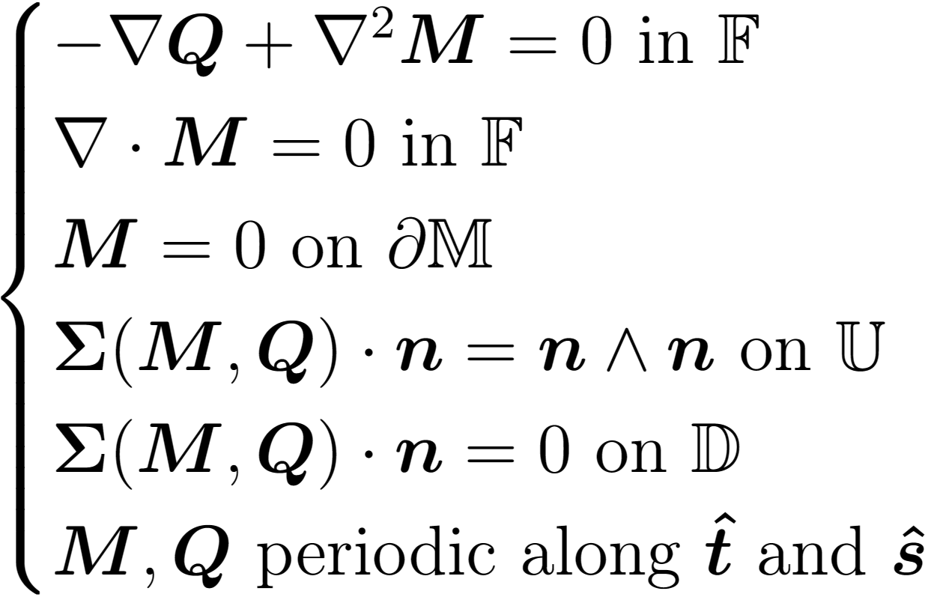
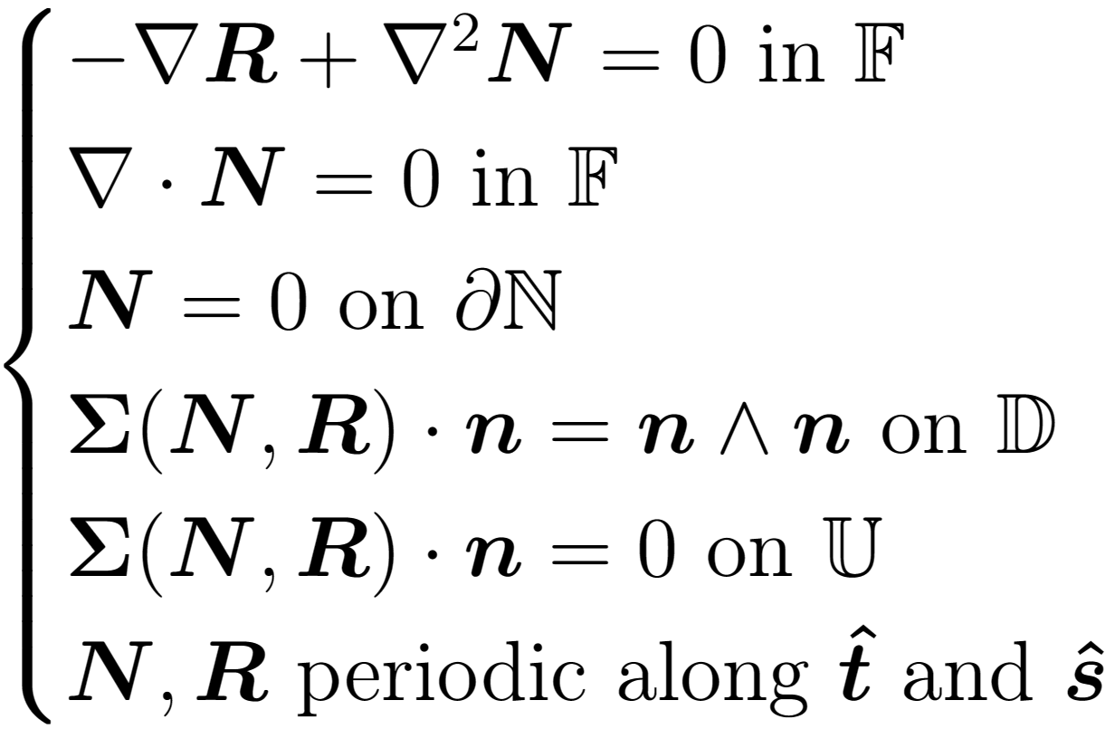
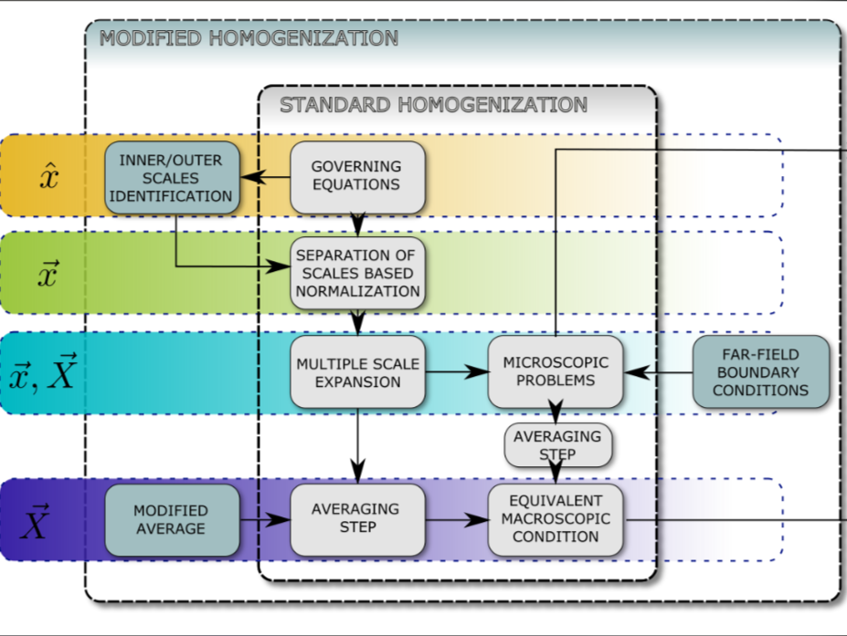
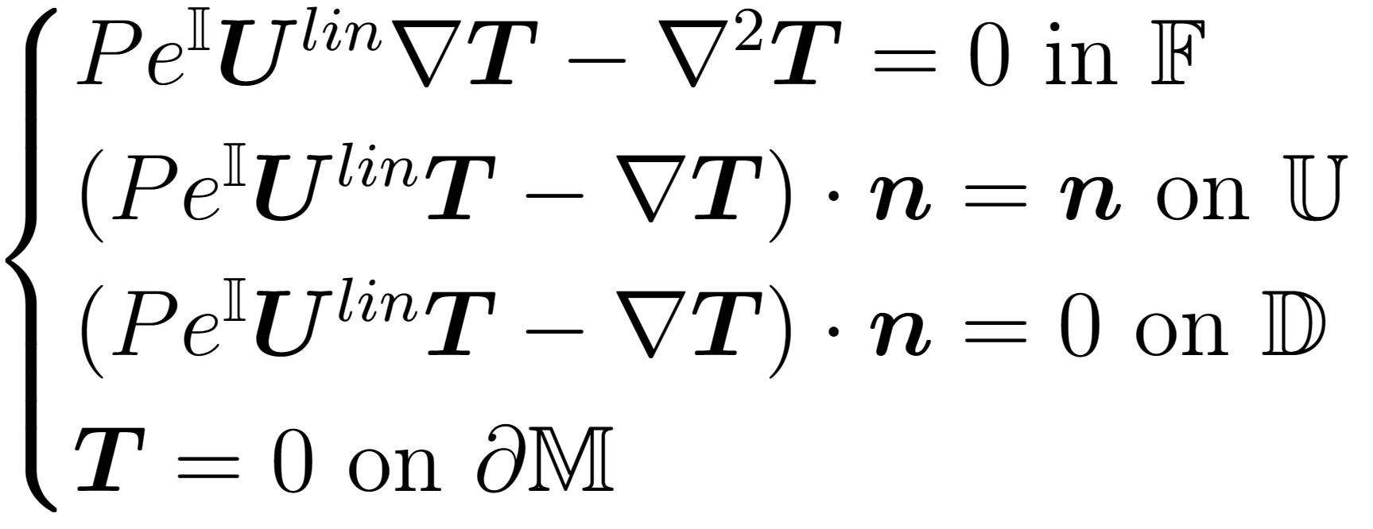
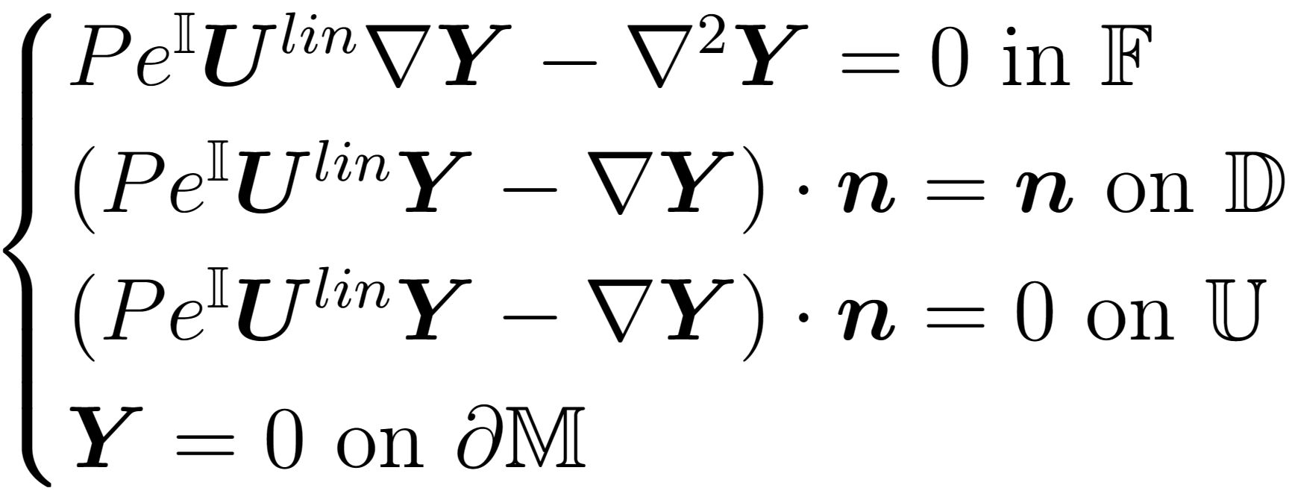
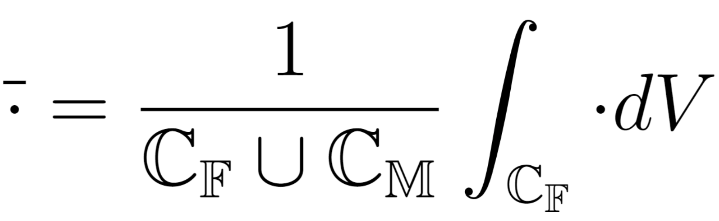
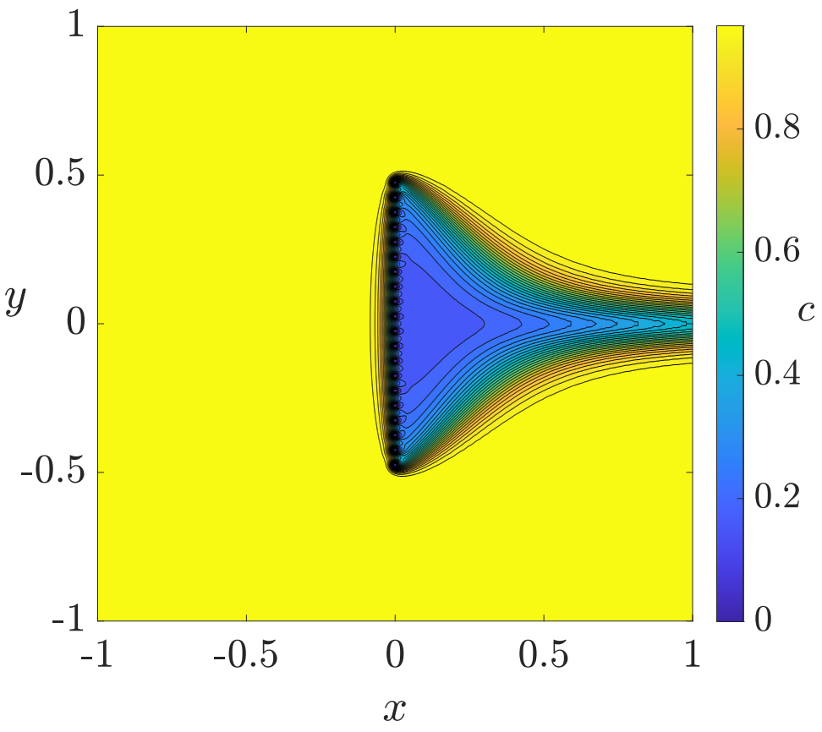

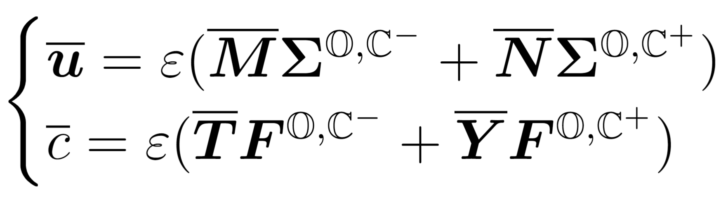

Homogenization procedure

Slide 5
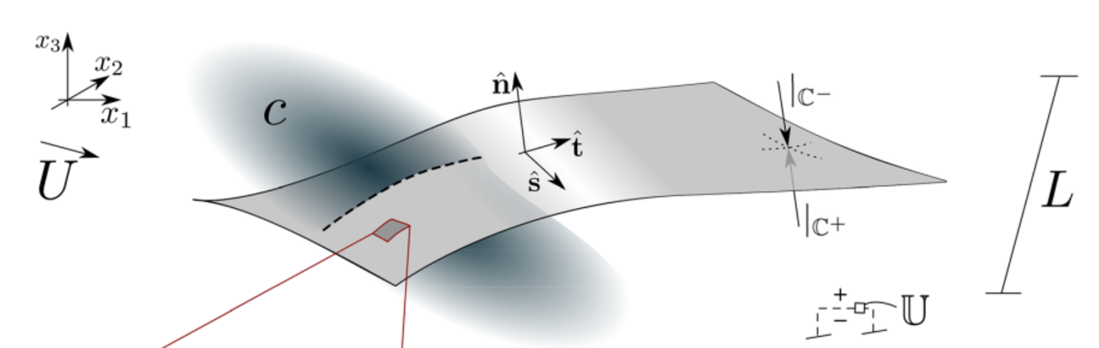
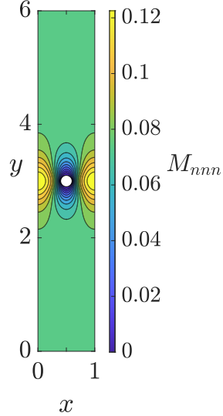
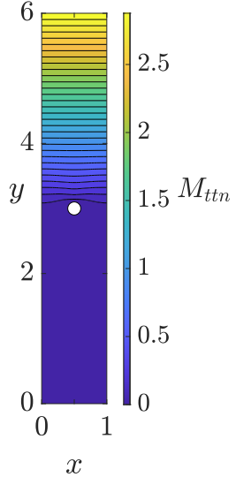
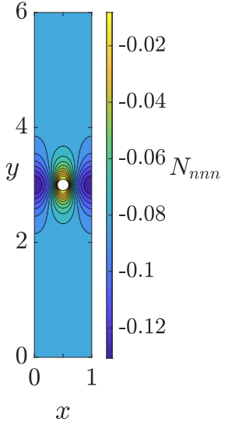
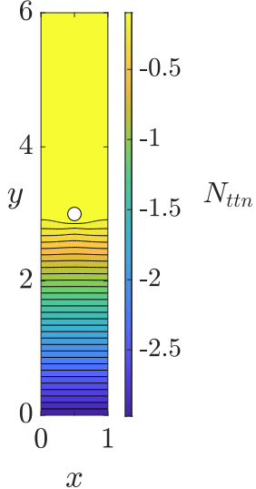


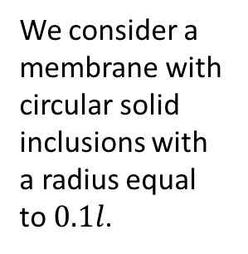
Microscopic problems for the solvent
We consider a membrane with circular solid inclusions with a radius equal to $0.1l$.

Slide 6
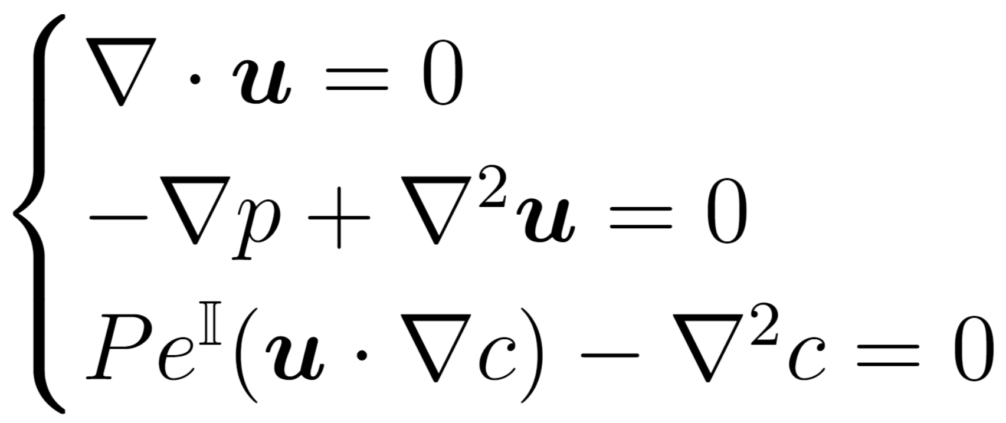
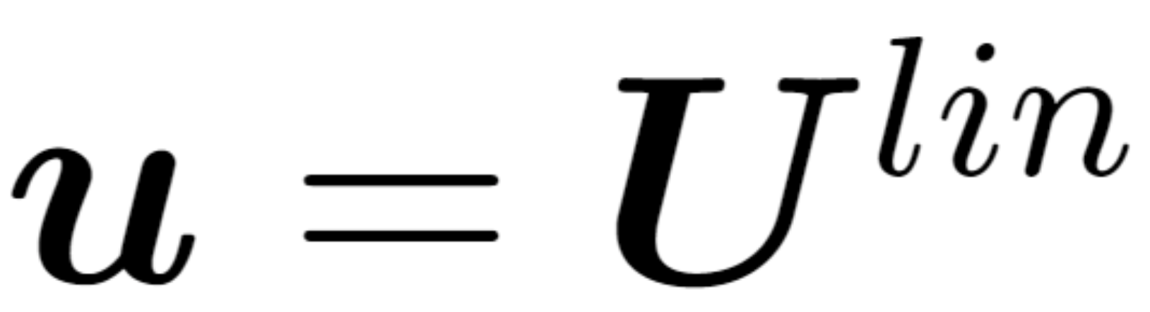
Microscopic problems for the solute
Linearizing the advective term:
The problem is coupled:
The microscopic problems become:
Two strategies are defined to specify .

Slide 7
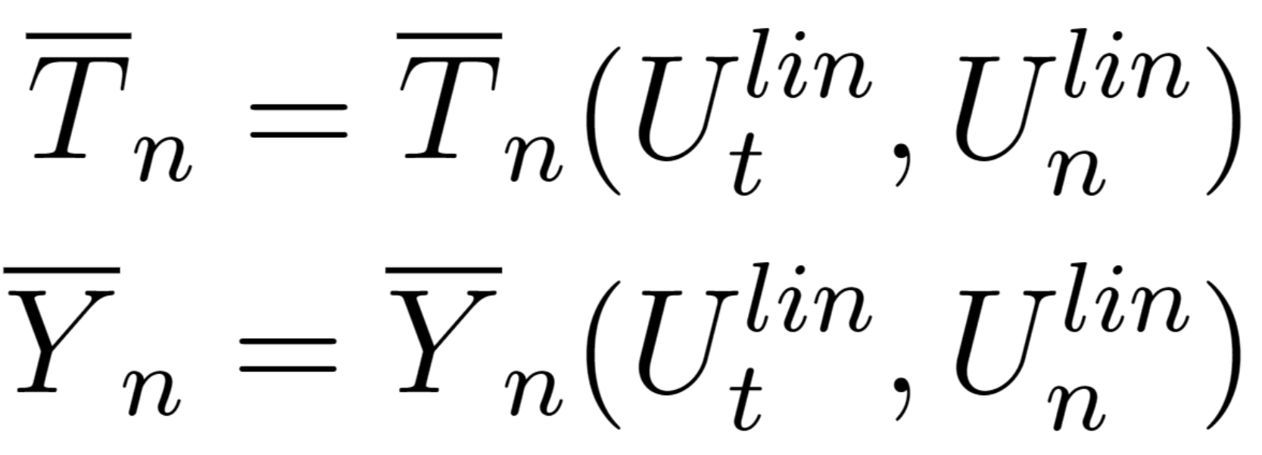
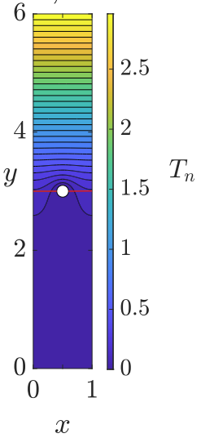
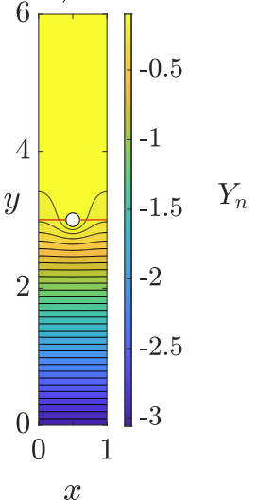
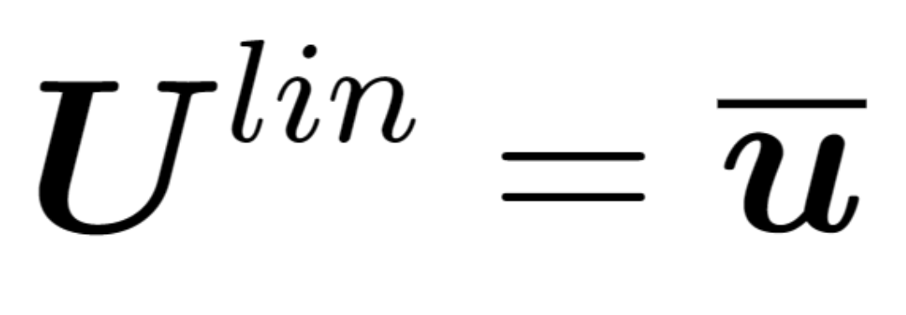
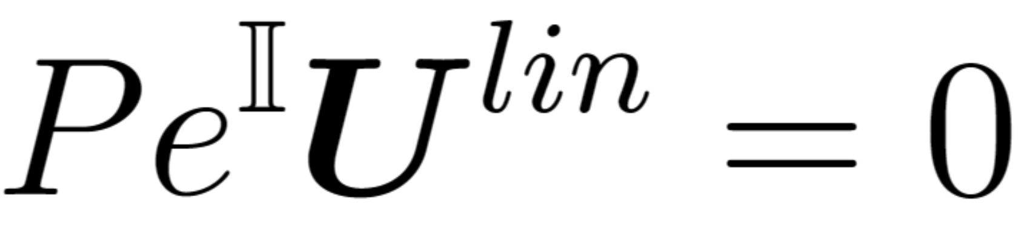
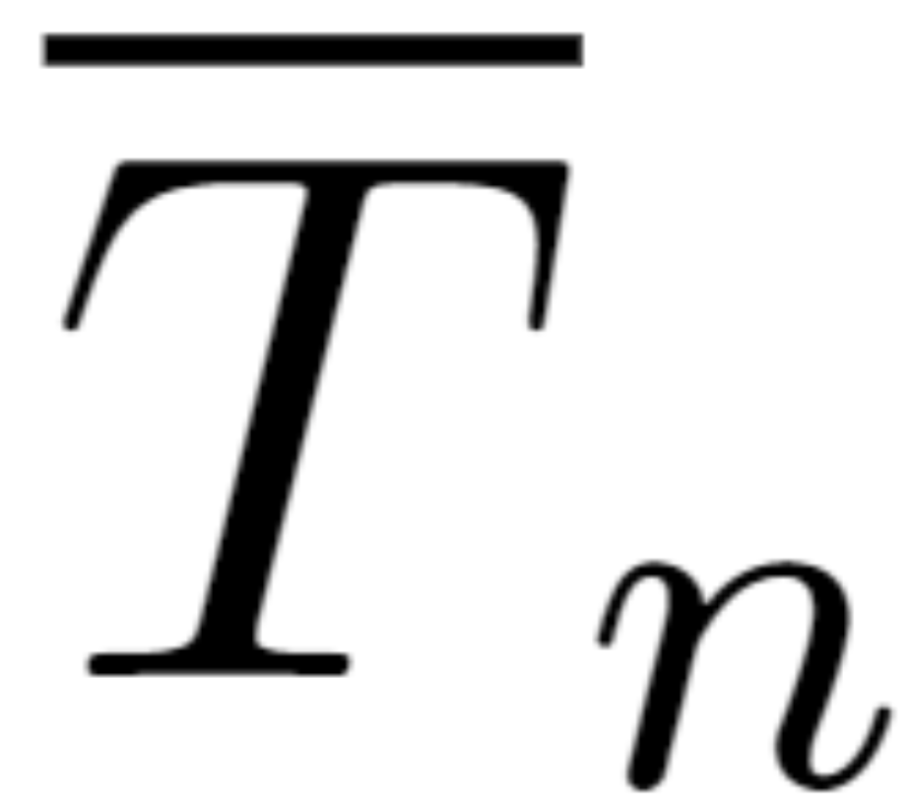
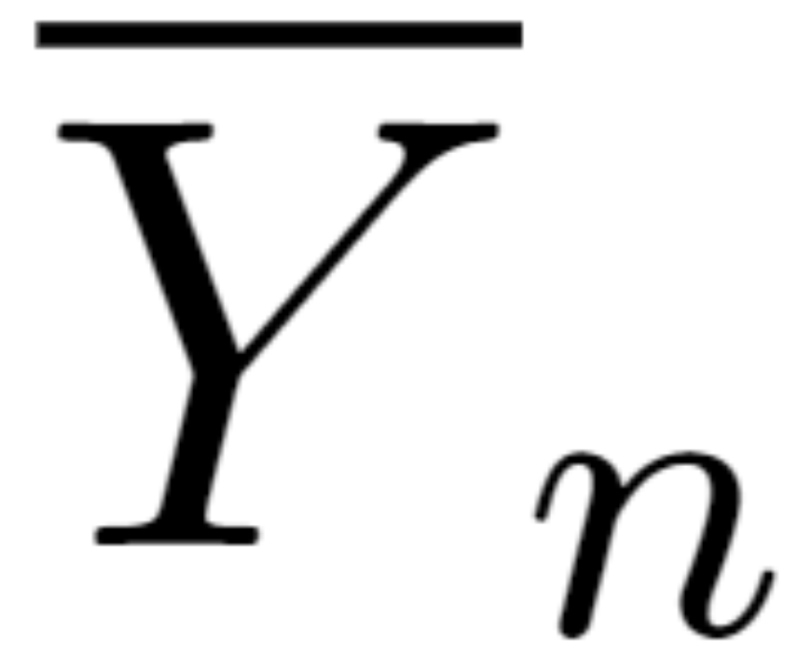
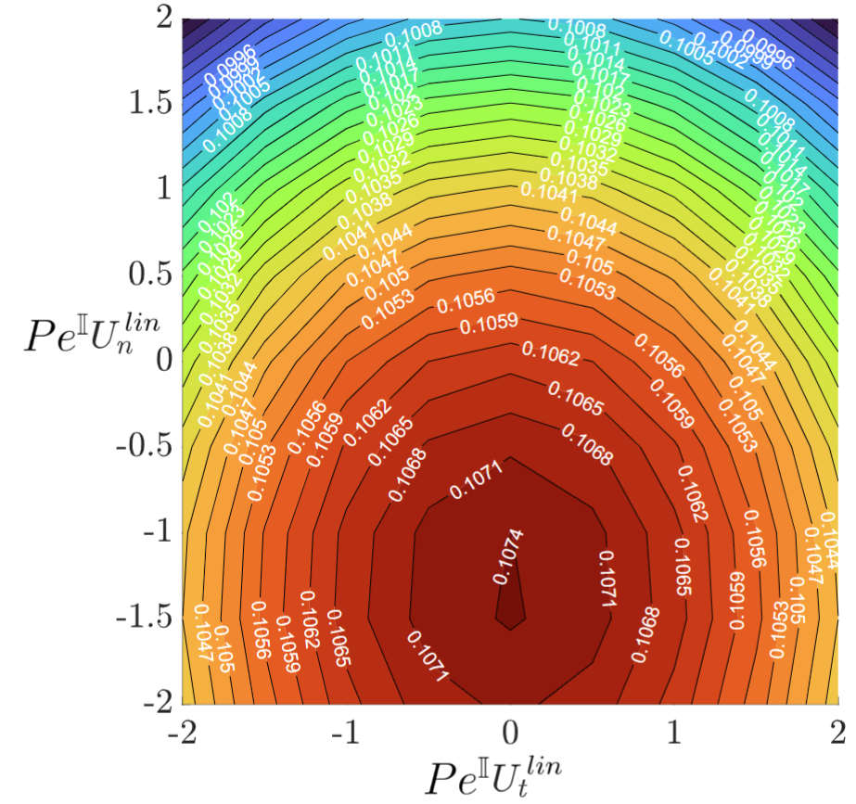
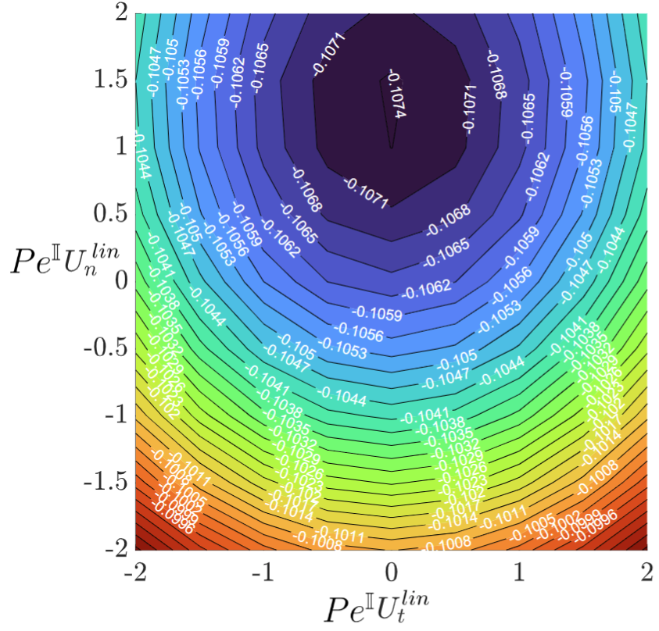
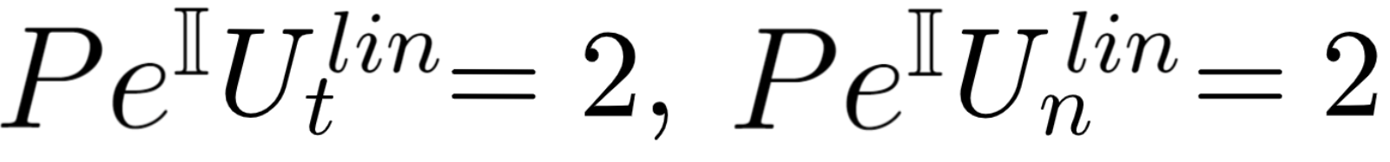
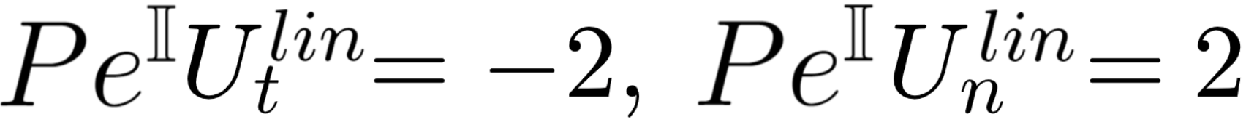
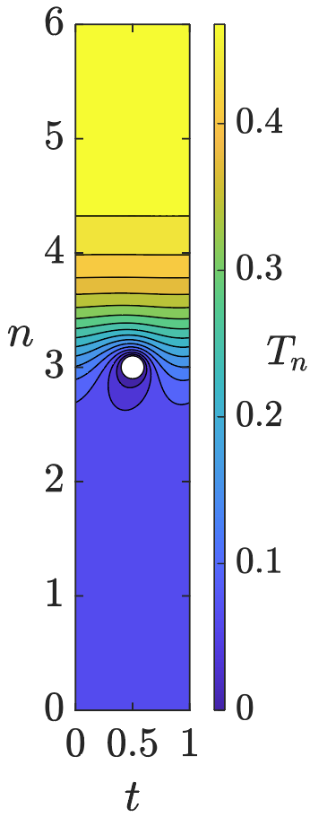
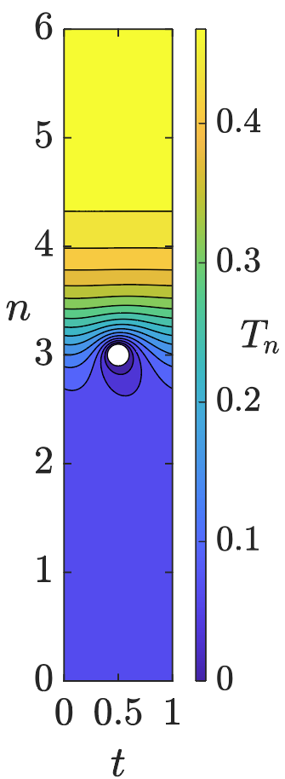
Strategy A
Oseen Linearization:

Slide 8
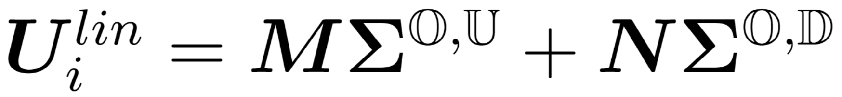
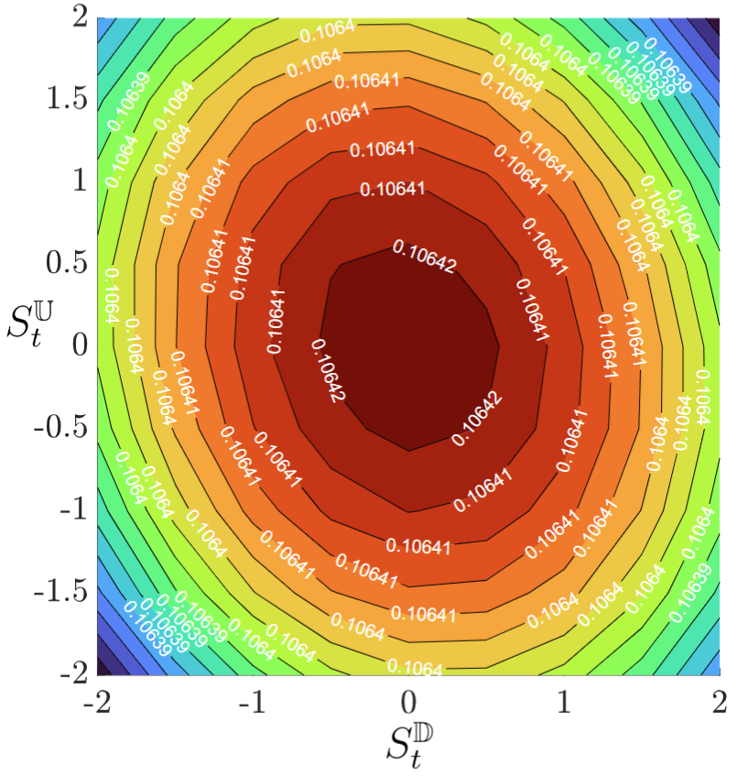
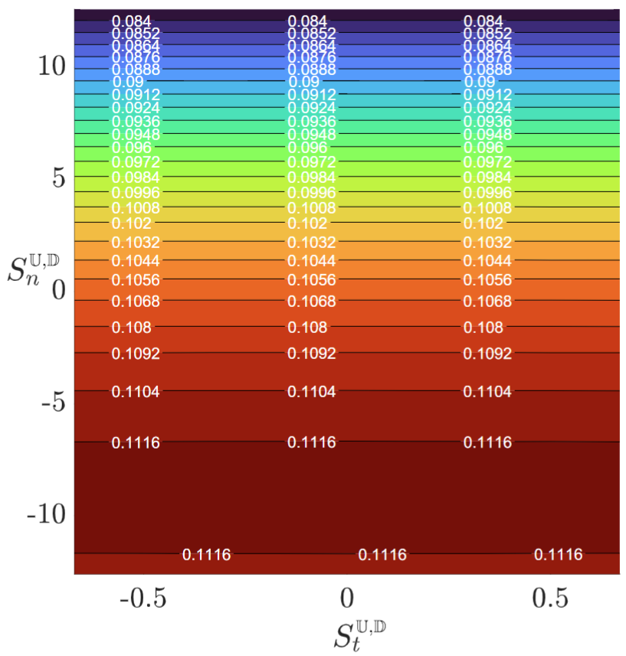
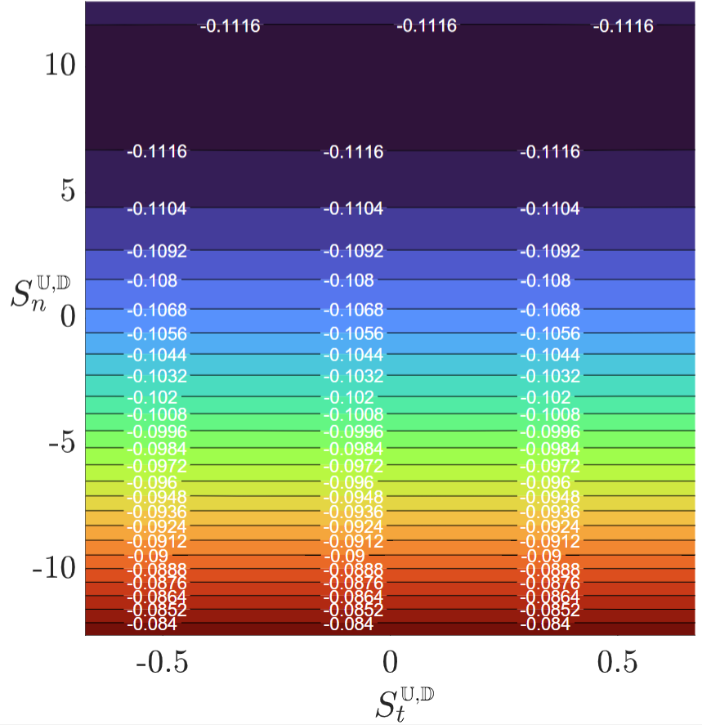
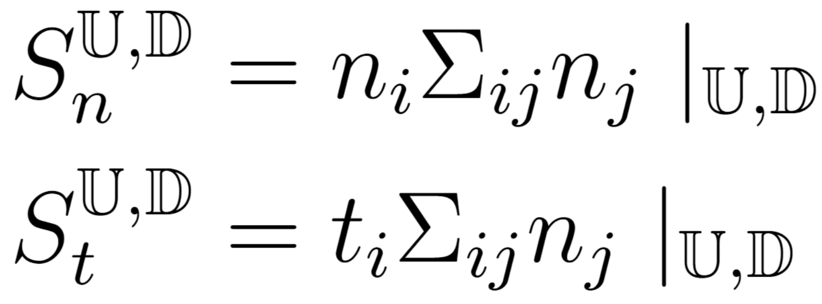
Strategy B
Microscopic velocity retrieved by the outer stresses:

Slide 9
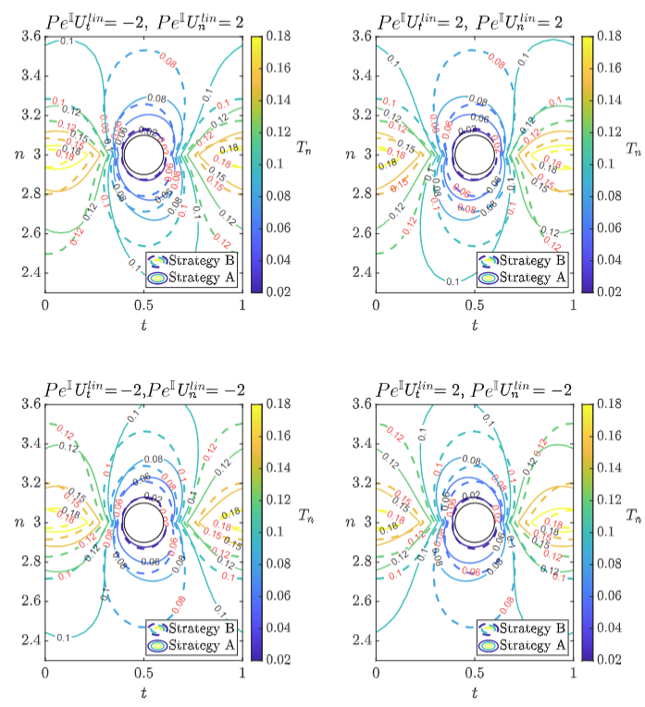
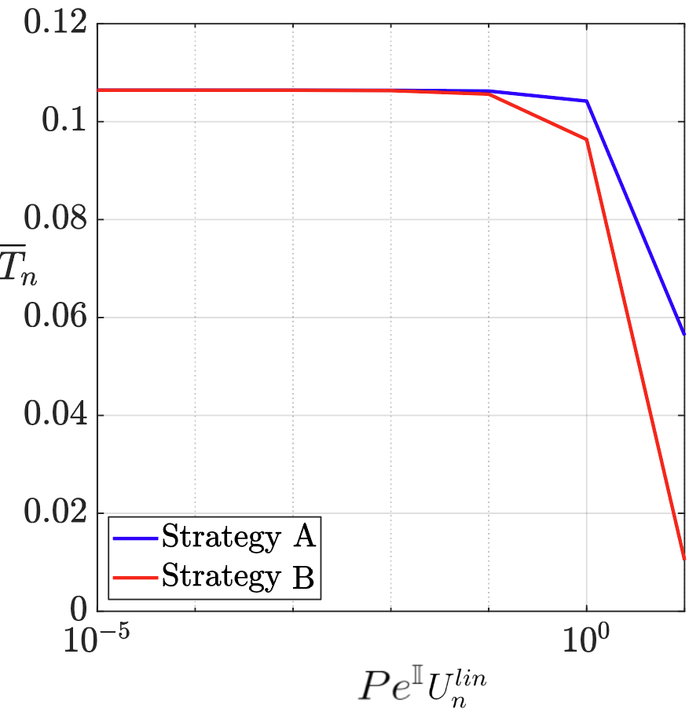
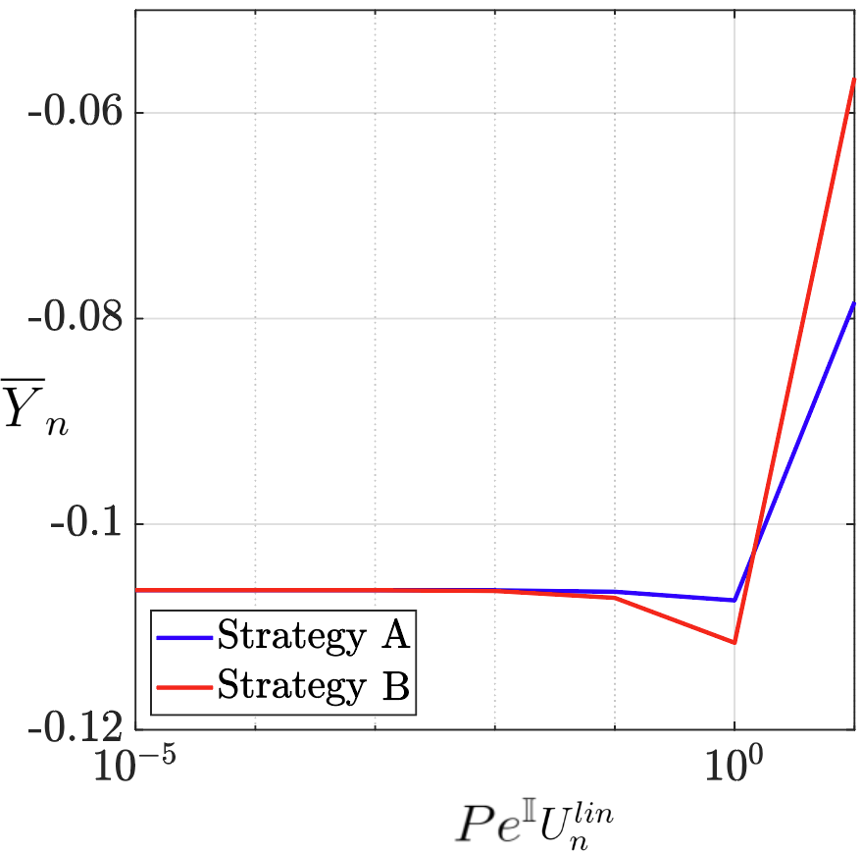
Comparison between the strategies
Different tensors fields
Different values of the averaged tensors

Slide 10
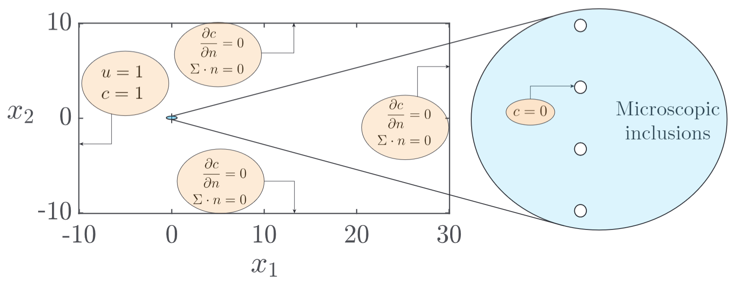
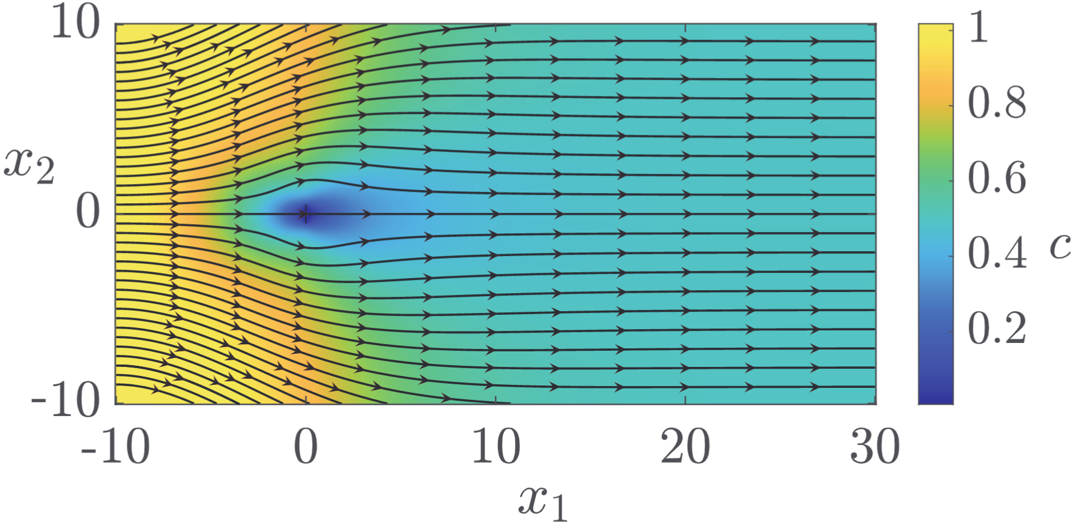
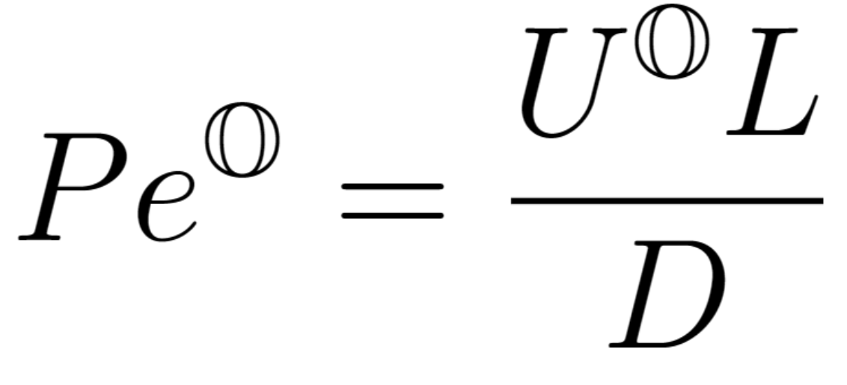

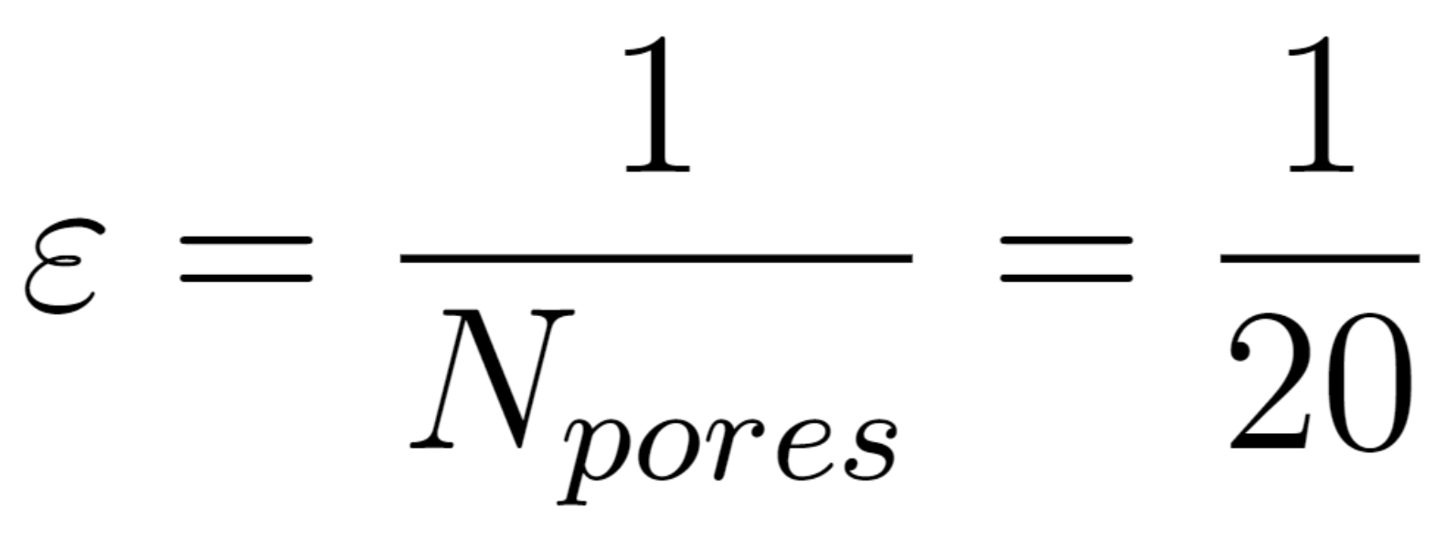





Macroscopic configuration: planar membrane

Slide 11










$${Pe}^{𝕆}=0,ε=0.05,{Re}^{𝕆}=0$$
The relative error is evaluated:
$${Pe}^{𝕆}=5/ε^{2}, ε=0.05,{Re}^{𝕆}=0$$

Slide 12










${Pe}^{𝕆}=10/ε^{2}$ $, ε=0.05,{Re}^{𝕆}=0$
$${Pe}^{𝕆}=80/ε, ε=0.01,{Re}^{𝕆}=40$$

Slide 13








$${Pe}^{𝕆}=80/ε, ε=0.01,{Re}^{𝕆}=60$$
Root mean square errors are evaluated as:

Slide 14









Macroscopic configuration: cylindrical membrane
$${Pe}^{𝕆}=1/ε^{4},ε=0.13,{Re}^{𝕆}=0$$

Slide 15


Conclusions and further developments
Strategy B predicts well the solute concentration for every case tested in the whole fluid domain, while strategy A underestimates the results of the direct numerical simulations for large Péclet numbers, as the diffusive case.
Further developments
Analyze the case where pores and particles have comparable diameters.
Study other types of solute-membrane interactions, like partially adsorbing or reactive inclusions.
Study non-periodic microscopic geometries.
Find the higher order approximation in the $ε$ expansion.

Slide 16
Thank you for your attention

